Slide 1

William Stallings
Computer Organization and Architecture
10th Edition
Notes:
Lecture slides prepared for “Computer Organization and Architecture”, 10/e, by William Stallings, Chapter 16 “Instruction-Level Parallelism and Superscalar Processors”.

Slide 2
Chapter 16
Instruction-Level Parallelism and Superscalar Processors
Notes:
A superscalar implementation of a processor architecture is one in which common instructions—integer and floating-point arithmetic, loads, stores, and conditional branches—can be initiated simultaneously and executed independently. Such implementations raise a number of complex design issues related to the instruction pipeline.
Superscalar design arrived on the scene hard on the heels of RISC architecture. Although the simplified instruction set architecture of a RISC machine lends itself readily to superscalar techniques, the superscalar approach can be used on either a RISC or CISC architecture.
Whereas the gestation period for the arrival of commercial RISC machines from the beginning of true RISC research with the IBM 801 and the Berkeley RISC I was seven or eight years, the first superscalar machines became commercially available within just a year or two of the coining of the term superscalar. The superscalar approach has now become the standard method for implementing high- performance microprocessors.
In this chapter, we begin with an overview of the superscalar approach, contrasting it with superpipelining. Next, we present the key design issues associated with superscalar implementation. Then we look at several important examples of superscalar architecture.

Slide 3
Supersca l ar
Term first coined in 1987
Refers to a machine that is designed to improve the performance of the execution of scalar instructions
Overview
In most applications the bulk of the operations are on scalar quantities
Represents the next step in the evolution of high-performance general-purpose processors
Essence of the approach is the ability to execute instructions independently and concurrently in different pipelines
Concept can be further exploited by allowing instructions to be executed in an order different from the program order
Notes:
The term superscalar, first coined in 1987 [AGER87], refers to a machine that is designed to improve the performance of the execution of scalar instructions. In most applications, the bulk of the operations are on scalar quantities. Accordingly, the superscalar approach represents the next step in the evolution of high-performance general-purpose processors.
The essence of the superscalar approach is the ability to execute instructions independently and concurrently in different pipelines. The concept can be further exploited by allowing instructions to be executed in an order different from the program order.

Slide 4
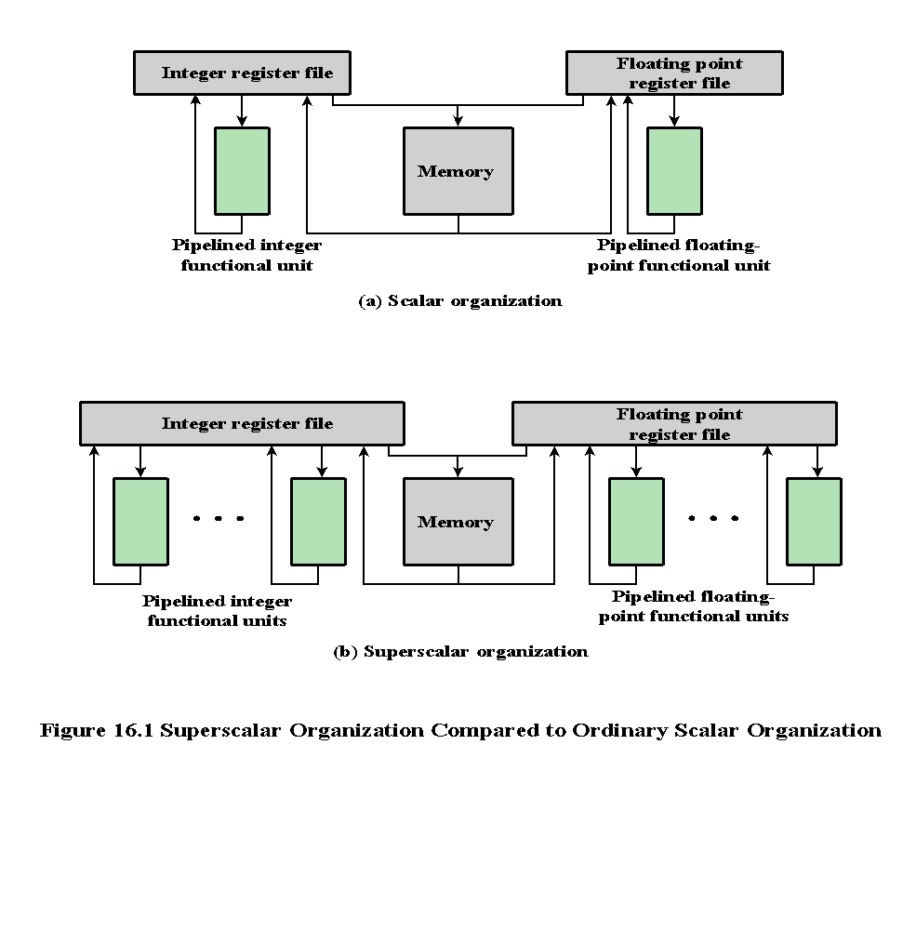
Notes:
Figure 16.1 compares, in general terms, the scalar and superscalar approaches. In a traditional scalar organization, there is a single pipelined functional unit for integer operations and one for floating-point operations. Parallelism is achieved by enabling multiple instructions to be at different stages of the pipeline at one time. In the superscalar organization, there are multiple functional units, each of which is implemented as a pipeline. Each individual functional unit provides a degree of parallelism by virtue of its pipelined structure. The use of multiple functional units enables the processor to execute streams of instructions in parallel, one stream for each pipeline. It is the responsibility of the hardware, in conjunction with the compiler, to assure that the parallel execution does not violate the intent of the program.

Slide 5
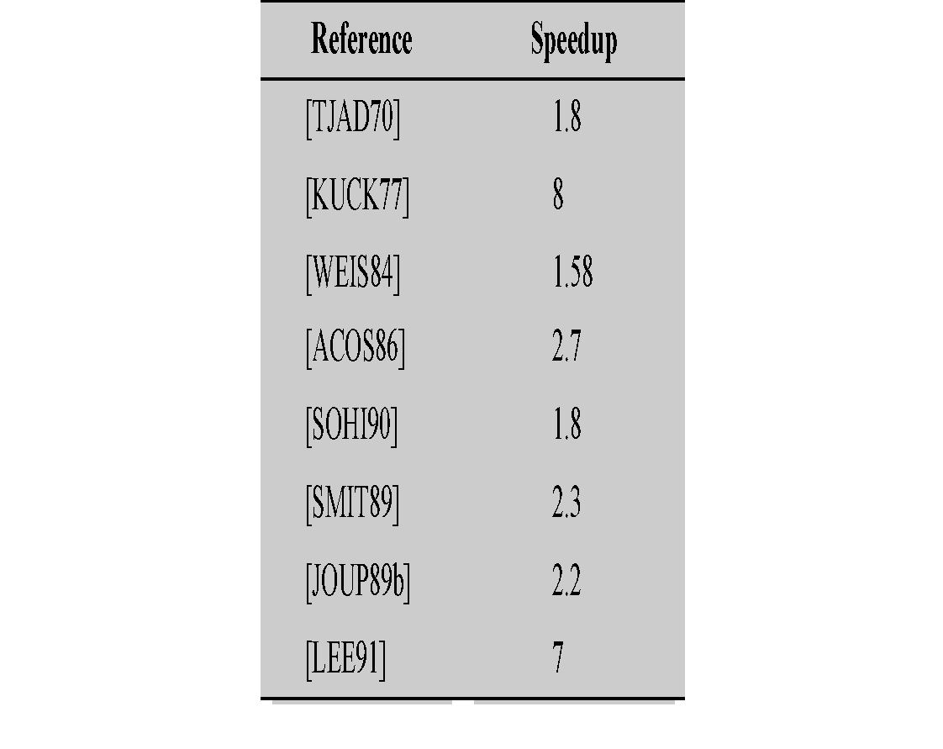
Table 16.1
Reported Speedups of
Superscalar-Like Machines
Notes:
Many researchers have investigated superscalar-like processors, and their research indicates that some degree of performance improvement is possible. Table 16.1 presents the reported performance advantages. The differences in the results arise from differences both in the hardware of the simulated machine and in the applications being simulated.

Slide 6
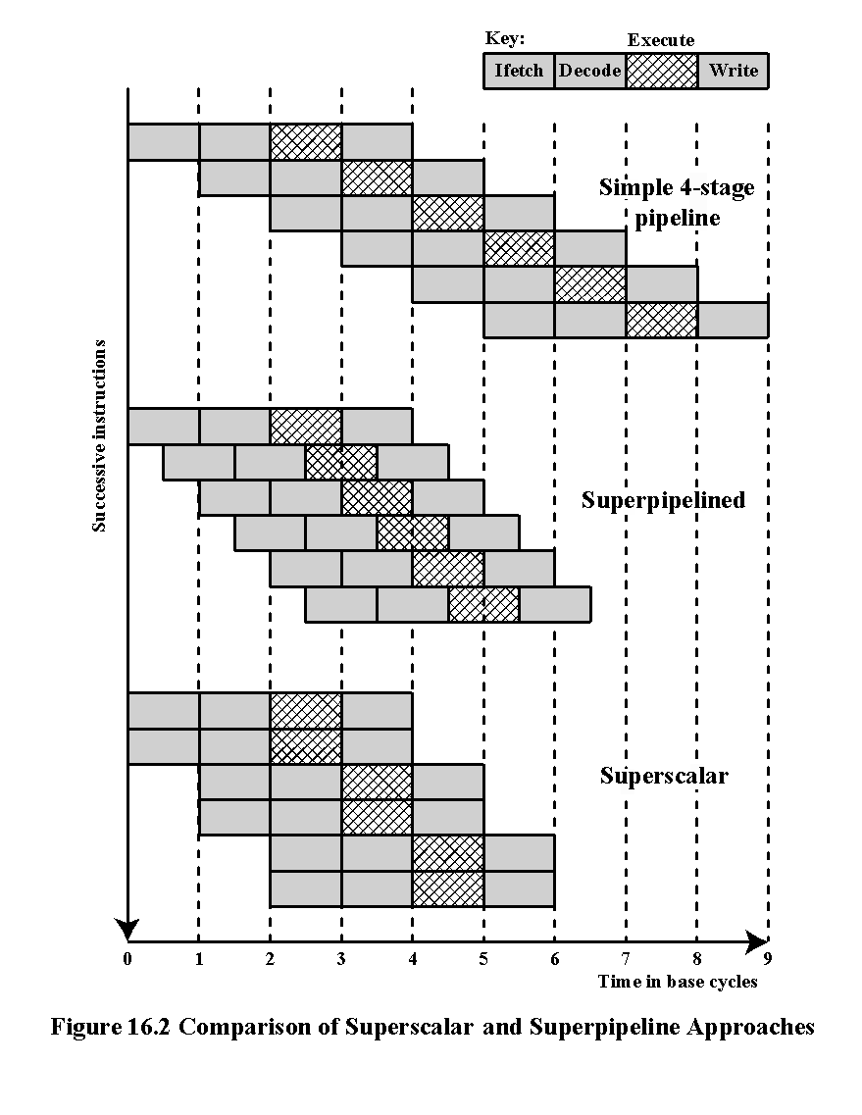
Notes:
An alternative approach to achieving greater performance is referred to as super- pipelining, a term first coined in 1988 [JOUP88]. Superpipelining exploits the fact that many pipeline stages perform tasks that require less than half a clock cycle. Thus, a doubled internal clock speed allows the performance of two tasks in one external clock cycle. We have seen one example of this approach with the MIPS R4000.
Figure 16.2 compares the two approaches. The upper part of the diagram illustrates an ordinary pipeline, used as a base for comparison. The base pipeline issues one instruction per clock cycle and can perform one pipeline stage per clock cycle. The pipeline has four stages: instruction fetch, operation decode, operation execution, and result write back. The execution stage is crosshatched for clarity. Note that although several instructions are executing concurrently, only one instruction is in its execution stage at any one time.
The next part of the diagram shows a superpipelined implementation that is capable of performing two pipeline stages per clock cycle. An alternative way of looking at this is that the functions performed in each stage can be split into two non-overlapping parts and each can execute in half a clock cycle. A superpipeline implementation that behaves in this fashion is said to be of degree 2. Finally, the lowest part of the diagram shows a superscalar implementation capable of executing two instances of each stage in parallel. Higher-degree superpipeline and super- scalar implementations are of course possible.
Both the superpipeline and the superscalar implementations depicted in Figure 16.2 have the same number of instructions executing at the same time in the steady state. The superpipelined processor falls behind the superscalar processor at the start of the program and at each branch target.

Slide 7
Constraints
Instruction level parallelism
  Refers to the degree to which the instructions of a program can be executed in parallel
  A combination of compiler based optimization and hardware techniques can be used to maximize instruction level parallelism
Limitations:
  True data dependency
  Procedural dependency
  Resource conflicts
  Output dependency
  Antidependency
Notes:
The superscalar approach depends on the ability to execute multiple instructions in parallel. The term instruction-level parallelism refers to the degree to which, on average, the instructions of a program can be executed in parallel. A combination of compiler-based optimization and hardware techniques can be used to maximize instruction-level parallelism. Before examining the design techniques used in super- scalar machines to increase instruction-level parallelism, we need to look at the fundamental limitations to parallelism with which the system must cope. [JOHN91] lists five limitations:
• True data dependency
• Procedural dependency
• Resource conflicts
• Output dependency
• Antidependency

Slide 8
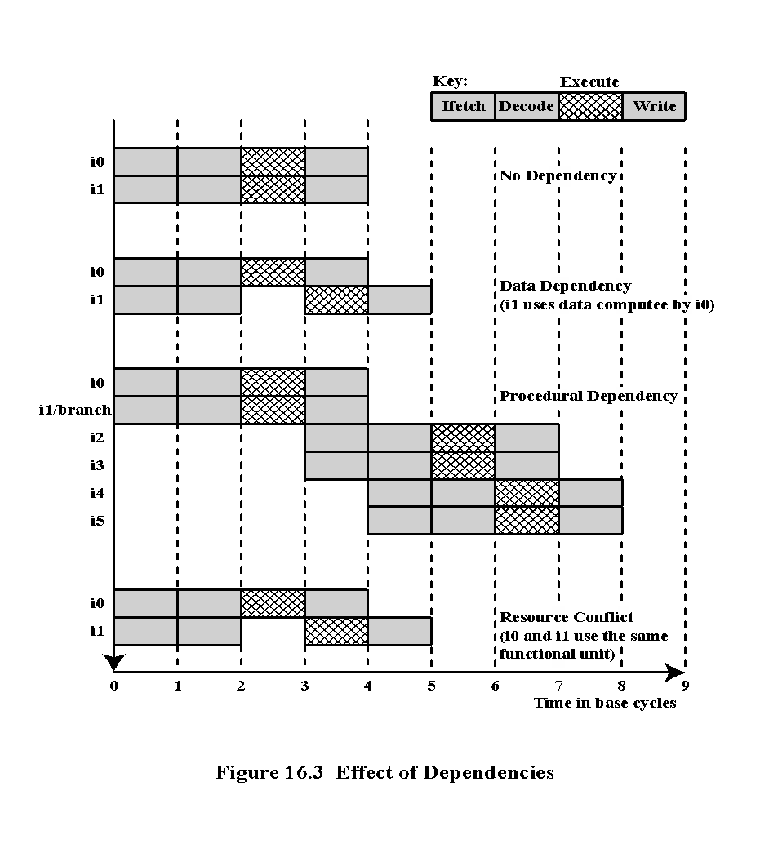
Notes:
As was discussed in Chapter 14, the presence of branches in an instruction sequence complicates the pipeline operation. The instructions following a branch (taken or not taken) have a procedural dependency on the branch and cannot be executed until the branch is executed. Figure 16.3 illustrates the effect of a branch on a superscalar pipeline of degree 2.
As we have seen, this type of procedural dependency also affects a scalar pipe- line. The consequence for a superscalar pipeline is more severe, because a greater magnitude of opportunity is lost with each delay.
If variable-length instructions are used, then another sort of procedural dependency arises. Because the length of any particular instruction is not known, it must be at least partially decoded before the following instruction can be fetched. This prevents the simultaneous fetching required in a superscalar pipeline. This is one of the reasons that superscalar techniques are more readily applicable to a RISC or RISC-like architecture, with its fixed instruction length.
A resource conflict is a competition of two or more instructions for the same resource at the same time. Examples of resources include memories, caches, buses, register-file ports, and functional units (e.g., ALU adder).
In terms of the pipeline, a resource conflict exhibits similar behavior to a data dependency (Figure 16.3). There are some differences, however. For one thing, re- source conflicts can be overcome by duplication of resources, whereas a true data dependency cannot be eliminated. Also, when an operation takes a long time to complete, resource conflicts can be minimized by pipelining the appropriate functional unit.

Slide 9
Design Issues
Instruction-Level Parallelism
and Machine Parallelism
Instruction level parallelism
  Instructions in a sequence are independent
  Execution can be overlapped
  Governed by data and procedural dependency
Machine Parallelism
  Ability to take advantage of instruction level parallelism
  Governed by number of parallel pipelines
Notes:
[JOUP89a] makes an important distinction between the two related concepts of instruction-level parallelism and machine parallelism. Instruction-level parallelism exists when instructions in a sequence are independent and thus can be executed in parallel by overlapping.
The degree of instruction-level parallelism is determined by the frequency of true data dependencies and procedural dependencies in the code. These factors, in turn, are dependent on the instruction set architecture and on the application. Instruction-level parallelism is also determined by what [JOUP89a] refers to as operation latency: the time until the result of an instruction is available for use as an operand in a subsequent instruction. The latency determines how much of a delay a data or procedural dependency will cause.
Machine parallelism is a measure of the ability of the processor to take advantage of instruction-level parallelism. Machine parallelism is determined by the number of instructions that can be fetched and executed at the same time (the number of parallel pipelines) and by the speed and sophistication of the mechanisms that the processor uses to find independent instructions.
Both instruction-level and machine parallelism are important factors in enhancing performance. A program may not have enough instruction-level parallel- ism to take full advantage of machine parallelism. The use of a fixed-length instruction set architecture, as in a RISC, enhances instruction-level parallelism. On the other hand, limited machine parallelism will limit performance no matter what the nature of the program.

Slide 10
Instruction Issue Policy
  Refers to the process of initiating instruction execution in the processor’s functional units
  Refers to the protocol used to issue instructions
  Instruction issue occurs when instruction moves from the decode stage of the pipeline to the first execute stage of the pipeline
Instruction issue
Instruction issue policy
Superscalar instruction issue policies can be grouped into the following categories:
Three types of orderings are important:
  In-order issue with in-order completion
  In-order issue with out-of-order completion
  Out-of-order issue with out-of-order completion
  The order in which instructions are fetched
  The order in which instructions are executed
  The order in which instructions update the contents of register and memory locations
Notes:
As was mentioned, machine parallelism is not simply a matter of having multiple instances of each pipeline stage. The processor must also be able to identify instruction-level parallelism and orchestrate the fetching, decoding, and execution of instructions in parallel. [JOHN91] uses the term instruction issue to refer to the process of initiating instruction execution in the processor’s functional units and the term instruction issue policy to refer to the protocol used to issue instructions. In general, we can say that instruction issue occurs when instruction moves from the decode stage of the pipeline to the first execute stage of the pipeline.
In general terms, we can group superscalar instruction issue policies into the
following categories:
• In-order issue with in-order completion
• In-order issue with out-of-order completion
• Out-of-order issue with out-of-order completion
In essence, the processor is trying to look ahead of the current point of execution to locate instructions that can be brought into the pipeline and executed. Three types of orderings are important in this regard:
The order in which instructions are fetched
The order in which instructions are executed
The order in which instructions update the contents of register and memory locations
The more sophisticated the processor, the less it is bound by a strict relation- ship between these orderings. To optimize utilization of the various pipeline elements, the processor will need to alter one or more of these orderings with respect to the ordering to be found in a strict sequential execution. The one constraint on the processor is that the result must be correct. Thus, the processor must accommodate the various dependencies and conflicts discussed earlier.

Slide 11
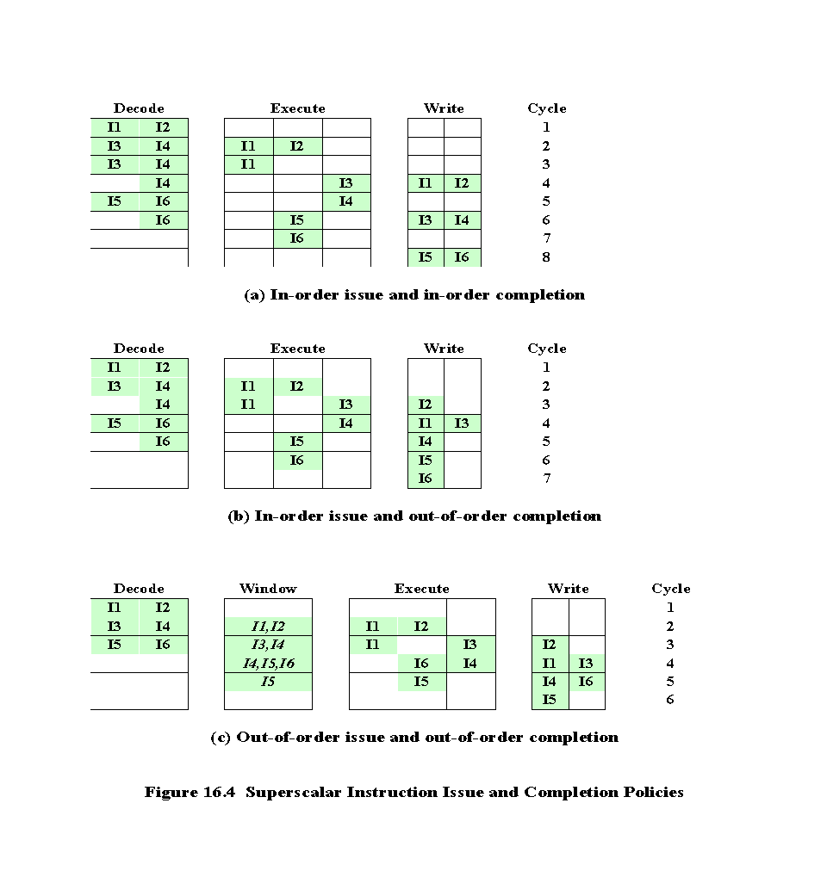
Notes:
The simplest instruction issue policy is to issue instructions in the exact order that would be achieved by sequential execution (in-order issue) and to write results in that same order (in-order completion). Not even scalar pipelines follow such a simple-minded policy. However, it is useful to consider this policy as a baseline for comparing more sophisticated approaches.
Figure 16.4a gives an example of this policy. We assume a superscalar pipeline capable of fetching and decoding two instructions at a time, having three separate functional units (e.g., two integer arithmetic and one floating-point arithmetic), and having two instances of the write-back pipeline stage. The example assumes the fol- lowing constraints on a six-instruction code fragment:
I1 requires two cycles to execute.
I3 and I4 conflict for the same functional unit.
I5 depends on the value produced by I4.
I5 and I6 conflict for a functional unit.
Instructions are fetched two at a time and passed to the decode unit. Because instructions are fetched in pairs, the next two instructions must wait until the pair of decode pipeline stages has cleared. To guarantee in-order completion, when there is a conflict for a functional unit or when a functional unit requires more than one cycle to generate a result, the issuing of instructions temporarily stalls.
In this example, the elapsed time from decoding the first instruction to writing the last results is eight cycles.
Out-of-order completion is used in scalar RISC processors to improve the performance of instructions that require multiple cycles. Figure 16.4b illustrates its use on a superscalar processor. Instruction I2 is allowed to run to completion prior to I1. This allows I3 to be completed earlier, with the net result of a savings of one cycle.
With out-of-order completion, any number of instructions may be in the execution stage at any one time, up to the maximum degree of machine parallelism across all functional units. Instruction issuing is stalled by a resource conflict, a data dependency, or a procedural dependency.
In addition to the aforementioned limitations, a new dependency, which we referred to earlier as an output dependency (also called write after write [WAW] dependency), arises.
Instruction I2 cannot execute before instruction I1, because it needs the result in register R3 produced in I1; this is an example of a true data dependency, as described in Section 16.1. Similarly, I4 must wait for I3, because it uses a result produced by I3. What about the relationship between I1 and I3? There is no data dependency here, as we have defined it. However, if I3 executes to completion prior to I1, then the wrong value of the contents of R3 will be fetched for the execution of I4. Consequently, I3 must complete after I1 to produce the correct output values. To ensure this, the issuing of the third instruction must be stalled if its result might later be overwritten by an older instruction that takes longer to complete.
Out-of-order completion requires more complex instruction issue logic than in-order completion. In addition, it is more difficult to deal with instruction interrupts and exceptions. When an interrupt occurs, instruction execution at the current point is suspended, to be resumed later. The processor must assure that the resumption takes into account that, at the time of interruption, instructions ahead of the instruction that caused the interrupt may already have completed.

Slide 12
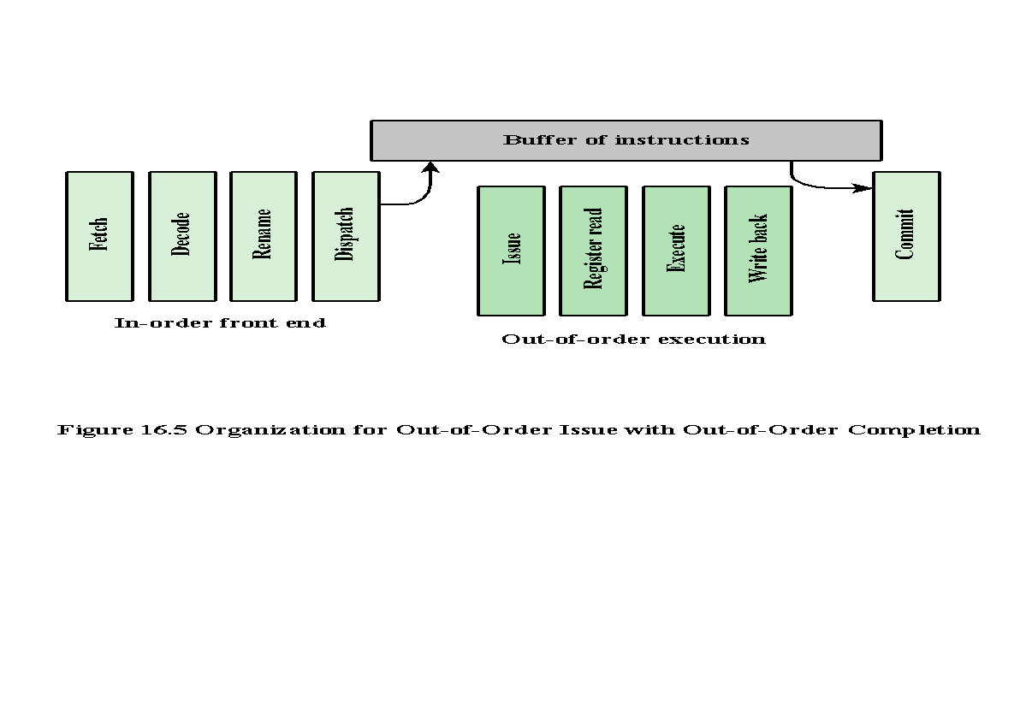
Notes:
With in-order issue, the processor will only decode instructions up to the point of a dependency or conflict. No additional instructions are decoded until the conflict is resolved. As a result, the processor cannot look ahead of the point of conflict to subsequent instructions that may be independent of those already in the pipeline and that may be usefully introduced into the pipeline.
To allow out-of-order issue, it is necessary to decouple the decode and exe- cute stages of the pipeline. This is done with a buffer referred to as an instruction window. With this organization, after a processor has finished decoding an instruction, it is placed in the instruction window. As long as this buffer is not full, the processor can continue to fetch and decode new instructions. When a functional unit becomes available in the execute stage, an instruction from the instruction window may be issued to the execute stage. Any instruction may be issued, provided that (1) it needs the particular functional unit that is available, and (2) no conflicts or dependencies block this instruction. Figure 16.5 suggests this organization.
The result of this organization is that the processor has a lookahead capability, allowing it to identify independent instructions that can be brought into the execute stage. Instructions are issued from the instruction window with little regard for their original program order. As before, the only constraint is that the program execution behaves correctly.
Figures 16.4c illustrates this policy. During each of the first three cycles, two instructions are fetched into the decode stage. During each cycle, subject to the constraint of the buffer size, two instructions move from the decode stage to the instruction window. In this example, it is possible to issue instruction I6 ahead of I5 (recall that I5 depends on I4, but I6 does not). Thus, one cycle is saved in both the execute and write-back stages, and the end-to-end savings, compared with Figure 16.4b, is one cycle.
The instruction window is depicted in Figure 16.4c to illustrate its role. However, this window is not an additional pipeline stage. An instruction being in the window simply implies that the processor has sufficient information about that instruction to decide when it can be issued.
The out-of-order issue, out-of-order completion policy is subject to the same constraints described earlier. An instruction cannot be issued if it violates a dependency or conflict. The difference is that more instructions are available for issuing, reducing the probability that a pipeline stage will have to stall. In addition, a new dependency, which we referred to earlier as an antidependency (also called write after read [WAR] dependency), arises.
Instruction I3 cannot complete execution before instruction I2 begins execution and has fetched its operands. This is so because I3 updates register R3, which is a source operand for I2. The term antidependency is used because the constraint is similar to that of a true data dependency, but reversed: Instead of the first instruction producing a value that the second instruction uses, the second instruction destroys a value that the first instruction uses.

Slide 13
Register Renaming
Output and antidependencies occur because register contents may not reflect the correct ordering from the program
May result in a pipeline stall
Registers allocated dynamically
Notes:
When out-of-order instruction issuing and/or out-of-order instruction completion are allowed, we have seen that this gives rise to the possibility of WAW dependencies and WAR dependencies. These dependencies differ from RAW data dependencies and resource conflicts, which reflect the flow of data through a program and the sequence of execution. WAW dependencies and WAR dependencies, on the other hand, arise because the values in registers may no longer reflect the sequence of values dictated by the program flow.
When instructions are issued in sequence and complete in sequence, it is possible to specify the contents of each register at each point in the execution. When out-of-order techniques are used, the values in registers cannot be fully known at each point in time just from a consideration of the sequence of instructions dictated by the program. In effect, values are in conflict for the use of registers, and the processor must resolve those conflicts by occasionally stalling a pipeline stage.
Antidependencies and output dependencies are both examples of storage conflicts. Multiple instructions are competing for the use of the same register locations, generating pipeline constraints that retard performance. The problem is made more acute when register optimization techniques are used (as discussed in Chapter 15), because these compiler techniques attempt to maximize the use of registers, hence maximizing the number of storage conflicts.
One method for coping with these types of storage conflicts is based on a traditional resource-conflict solution: duplication of resources. In this context, the technique is referred to as register renaming. In essence, registers are allocated dynamically by the processor hardware, and they are associated with the values needed by instructions at various points in time. When a new register value is created (i.e., when an instruction executes that has a register as a destination operand), a new register is allocated for that value. Subsequent instructions that access that value as a source operand in that register must go through a renaming process: the register references in those instructions must be revised to refer to the register containing the needed value. Thus, the same original register reference in several different instructions may refer to different actual registers, if different values are intended.
The register reference without the subscript refers to the logical register reference found in the instruction. The register reference with the subscript refers to a hardware register allocated to hold a new value. When a new allocation is made for a particular logical register, subsequent instruction references to that logical register as a source operand are made to refer to the most recently allocated hardware register (recent in terms of the program sequence of instructions).

Slide 14
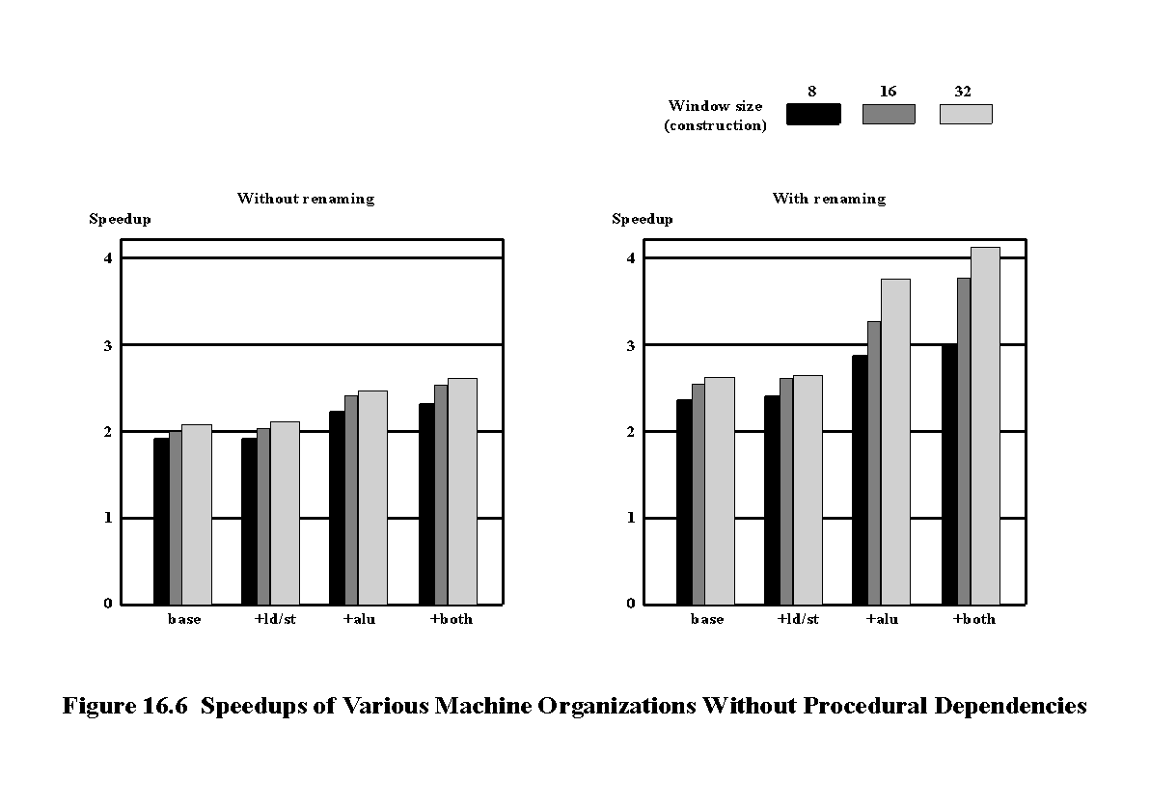
Notes:
In the preceding discussion, we have looked at three hardware techniques that can be used in a superscalar processor to enhance performance: duplication of resources, out-of-order issue, and renaming. One study that illuminates the relationship among these techniques was reported in [SMIT89]. The study made use of a simulation that modeled a machine with the characteristics of the MIPS R2000, augmented with various superscalar features. A number of different program sequences were simulated.
Figure 16.6 shows the results. In each of the graphs, the vertical axis corresponds to the mean speedup of the superscalar machine over the scalar machine. The horizontal axis shows the results for four alternative processor organizations. The base machine does not duplicate any of the functional units, but it can issue instructions out of order. The second configuration duplicates the load/store functional unit that accesses a data cache. The third configuration duplicates the ALU, and the fourth configuration duplicates both load/store and ALU. In each graph, results are shown for instruction window sizes of 8, 16, and 32 instructions, which dictates the amount of lookahead the processor can do. The difference between the two graphs is that, in the second, register renaming is allowed. This is equivalent to saying that the first graph reflects a machine that is limited by all dependencies, whereas the second graph corresponds to a machine that is limited only by true dependencies.
The two graphs, combined, yield some important conclusions. The first is that it is probably not worthwhile to add functional units without register renaming.
There is some slight improvement in performance, but at the cost of increased hard- ware complexity. With register renaming, which eliminates antidependencies and output dependencies, noticeable gains are achieved by adding more functional units. Note, however, that there is a significant difference in the amount of gain achievable between using an instruction window of 8 versus a larger instruction window. This indicates that if the instruction window is too small, data dependencies will prevent effective utilization of the extra functional units; the processor must be able to look quite far ahead to find independent instructions to utilize the hardware more fully.

Slide 15
Branch Prediction
Any high-performance pipelined machine must address the issue of dealing with branches
Intel 80486 addressed the problem by fetching both the next sequential instruction after a branch and speculatively fetching the branch target instruction
RISC machines:
  Delayed branch strategy was explored
  Processor always executes the single instruction that immediately follows the branch
  Keeps the pipeline full while the processor fetches a new instruction stream
Superscalar machines:
  Delayed branch strategy has less appeal
  Have returned to pre-RISC techniques of branch prediction
Notes:
Any high-performance pipelined machine must address the issue of dealing with branches. For example, the Intel 80486 addressed the problem by fetching both the next sequential instruction after a branch and speculatively fetching the branch tar- get instruction. However, because there are two pipeline stages between prefetch and execution, this strategy incurs a two-cycle delay when the branch gets taken.
With the advent of RISC machines, the delayed branch strategy was explored. This allows the processor to calculate the result of conditional branch instructions before any unusable instructions have been prefetched. With this method, the processor always executes the single instruction that immediately follows the branch. This keeps the pipeline full while the processor fetches a new instruction stream.
With the development of superscalar machines, the delayed branch strategy has less appeal. The reason is that multiple instructions need to execute in the delay slot, raising several problems relating to instruction dependencies. Thus, superscalar machines have returned to pre-RISC techniques of branch prediction. Some, like the PowerPC 601, use a simple static branch prediction technique. More sophisticated processors, such as the PowerPC 620 and the Pentium 4, use dynamic branch prediction based on branch history analysis.

Slide 16
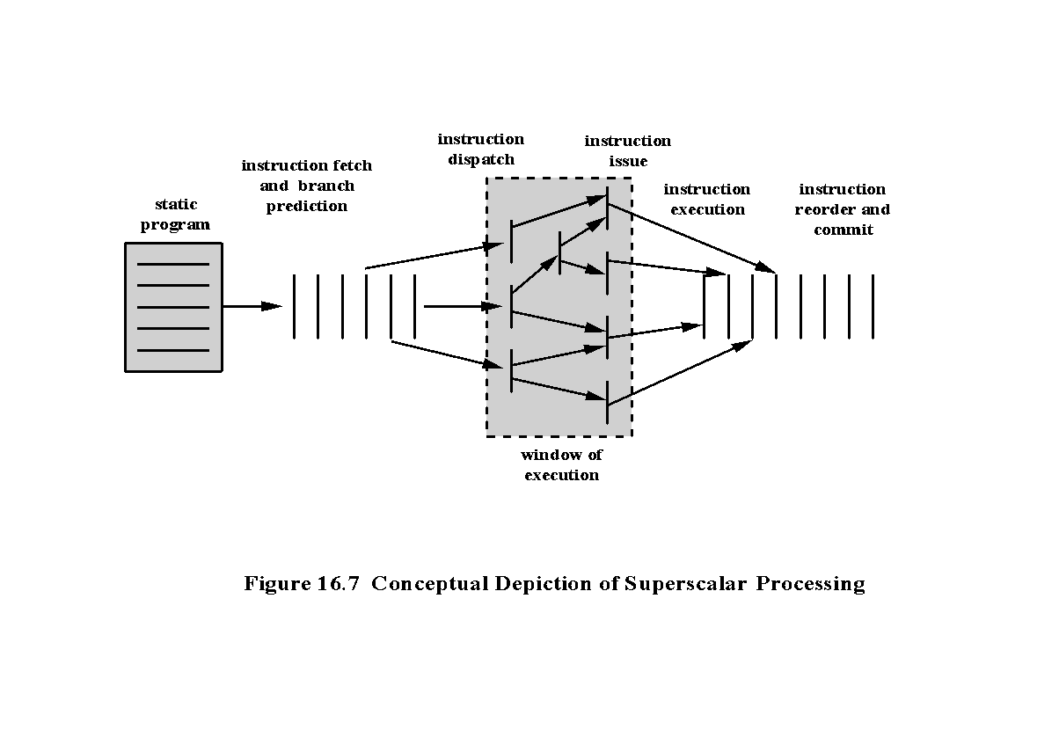
Notes:
We are now in a position to provide an overview of superscalar execution of pro- grams; this is illustrated in Figure 16.7. The program to be executed consists of a linear sequence of instructions. This is the static program as written by the programmer or generated by the compiler. The instruction fetch stage, which includes branch prediction, is used to form a dynamic stream of instructions. This stream is examined for dependencies, and the processor may remove artificial dependencies. The processor then dispatches the instructions into a window of execution. In this window, instructions no longer form a sequential stream but are structured according to their true data dependencies. The processor executes each instruction in an order determined by the true data dependencies and hardware resource availability. Finally, instructions are conceptually put back into sequential order and their results are recorded.
The final step mentioned in the preceding paragraph is referred to as committing, or retiring, the instruction. This step is needed for the following reason. Because of the use of parallel, multiple pipelines, instructions may complete in an order different from that shown in the static program. Further, the use of branch prediction and speculative execution means that some instructions may complete execution and then must be abandoned because the branch they represent is not taken. Therefore, permanent storage and program-visible registers cannot be updated immediately when instructions complete execution. Results must be held in some sort of temporary storage that is usable by dependent instructions and then made permanent when it is determined that the sequential model would have executed the instruction.

Slide 17
Superscalar Implementation
Key elements:
  Instruction fetch strategies that simultaneously fetch multiple instruction
  Logic for determining true dependencies involving register values, and mechanisms for communicating these values to where they are needed during execution
  Mechanisms for initiating, or issuing, multiple instructions in parallel
  Resources for parallel execution of multiple instructions, including multiple pipelined functional units and memory hierarchies capable of simultaneously servicing multiple memory references
  Mechanisms for committing the process state in correct order
Notes:
Based on our discussion so far, we can make some general comments about the processor hardware required for the superscalar approach. [SMIT95] lists the following key elements:
• Instruction fetch strategies that simultaneously fetch multiple instructions, often by predicting the outcomes of, and fetching beyond, conditional branch instructions. These functions require the use of multiple pipeline fetch and decode stages, and branch prediction logic.
Logic for determining true dependencies involving register values and mechanisms for communicating these values to where they are needed during execution.
Mechanisms for initiating, or issuing, multiple instructions in parallel.
Resources for parallel execution of multiple instructions, including multiple pipelined functional units and memory hierarchies capable of simultaneously servicing multiple memory references.
Mechanisms for committing the process state in correct order.

Slide 18
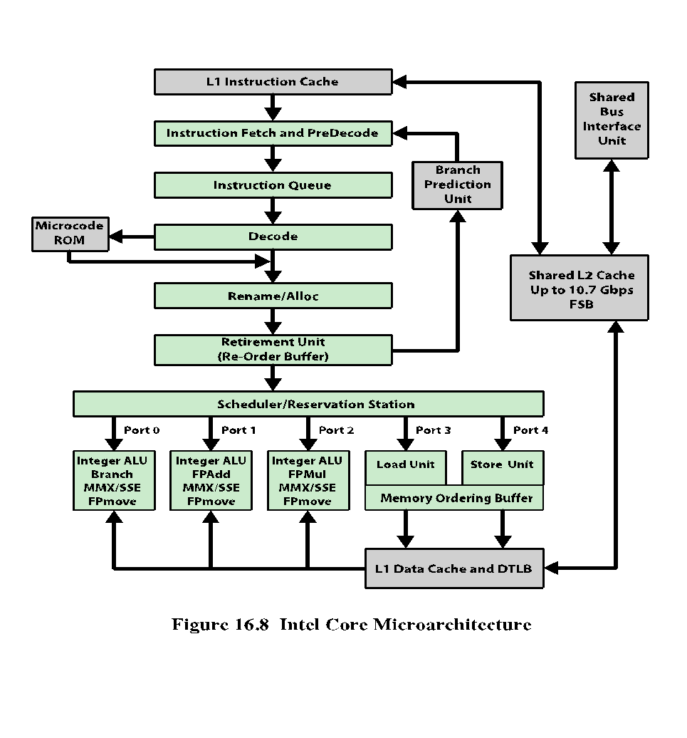
Notes:
Although the concept of superscalar design is generally associated with the RISC
architecture, the same superscalar principles can be applied to a CISC machine. Perhaps
the most notable example of this is the Intel x86 architecture. The evolution of
superscalar concepts in the Intel line is interesting to note. The 386 is a traditional
CISC nonpipelined machine. The 486 introduced the first pipelined x86 processor,
reducing the average latency of integer operations from between two and four cycles
to one cycle, but still limited to executing a single instruction each cycle, with no
superscalar elements. The original Pentium had a modest superscalar component,
consisting of the use of two separate integer execution units. The Pentium Pro introduced
a full-blown superscalar design with out-of-order execution. Subsequent x86
models have refined and enhanced the superscalar design.
Figure 16.8 shows the current version of the x86 pipeline architecture. Intel
refers to a pipeline architecture as a microarchitecture . The microarchitecture
underlies and implements the machine’s instruction set architecture. The microarchitecture
is referred to as the Intel Core Microarchitecture. It is implemented on
each processor core in the Intel Core 2 and Intel Xeon processor families. There is
also an Enhanced Intel Core Microarchitecture. One key difference between the
two microarchitectures is that the Enhanced Intel Core Microarchitecture provides
a third level of cache.

Slide 19
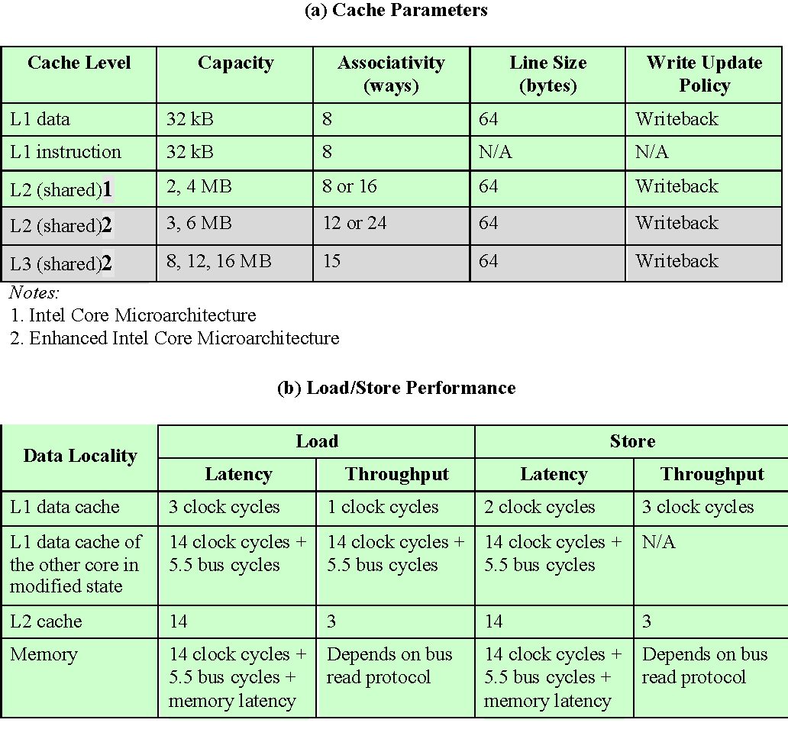
Table 16.2
Cache/Memory Parameters
and
Performance
of
Processors
Based on
Intel Core Microarchitecture
(Table can be found on
page 592 in the textbook.)
Notes:
Table 16.2 shows some of the parameters and performance characteristics of
the cache architecture. All of the caches use a writeback update policy. When an
instruction reads data from a memory location, the processor looks for the cache
line that contains this data in the caches and main memory in the following order:
1. L1 data cache of the initiating core
2. L1 data cache of other cores and L2 cache
System memory
The cache line is taken from the L1 data cache of another core only if it is
modified, ignoring the cache line availability or state in the L2 cache. Table 16.2b
shows the characteristics of fetching the first four bytes of different localities from
the memory cluster. The latency column provides an estimate of access latency.
However, the actual latency can vary depending on the load of cache, memory components,
and their parameters.
The pipeline of the Intel Core microarchitecture contains:
■ An in-order issue front end that fetches instruction streams from memory, with
four instruction decoders to supply decoded instructions to the out-of-order
execution core. Each instruction is translated into one or more fixed-length
RISC instructions, known as micro-operations , or micro-ops .
■ An out-of-order superscalar execution core that can issue up to six micro-ops
per cycle and reorder micro-ops to execute as soon as sources are ready and
execution resources are available.
■ An in-order retirement unit that ensures the results of execution of microops
are processed and architectural states and the processor's register set are
updated according to the original program order.
In effect, the Intel Core Microarchitecture implements a CISC instruction set
architecture on a RISC microarchitecture. The inner RISC micro-ops pass through
a pipeline with at least 14 stages; in some cases, the micro-op requires multiple execution
stages, resulting in an even longer pipeline. This contrasts with the five-stage
pipeline (Figure 14.21) used on the earlier Intel x86 processors and on the Pentium.

Slide 20
Front End
Consists of three major components:
Branch prediction unit (BPU)
Instruction fetch and predecode unit
Instruction queue and decode unit
Notes:
The front end needs to supply decoded instructions (micro-ops) and sustain the
stream to a six-issue wide out-of-order engine. It consists of three major components:
branch prediction unit (BPU), instruction fetch and predecode unit, and instruction
queue and decode unit.

Slide 21
Branch Prediction Unit
Helps the instruction fetch unit fetch the most likely instruction to be executed by predicting the various branch types:
  Conditional
  Indirect
  Direct
  Call
  Return
  Uses dedicated hardware for each branch type
  Enables the processor to begin executing instructions long before the branch outcome is decided
  A branch target buffer (BTB) is maintained that caches information about recently encountered branch instructions
Notes:
This unit helps the instruction fetch unit fetch the
most likely instruction to be executed by predicting the various branch types:
conditional, indirect, direct, call, and return. The BPU uses dedicated hardware
for each branch type. Branch prediction enables the processor to begin executing
instructions long before the branch outcome is decided.
The microarchitecture uses a dynamic branch prediction strategy based on the
history of recent executions of branch instructions. A branch target buffer (BTB) is
maintained that caches information about recently encountered branch instructions.
Whenever a branch instruction is encountered in the instruction stream, the BTB
is checked. If an entry already exists in the BTB, then the instruction unit is guided
by the history information for that entry in determining whether to predict that the
branch is taken. If a branch is predicted, then the branch destination address associated
with this entry is used for prefetching the branch target instruction.
Once the instruction is executed, the history portion of the appropriate entry
is updated to reflect the result of the branch instruction. If this instruction is not
represented in the BTB, then the address of this instruction is loaded into an entry
in the BTB; if necessary, an older entry is deleted.
The description of the preceding two paragraphs fits, in general terms, the
branch prediction strategy used on the original Pentium model, as well as the later
Pentium models, including current Intel models. However, in the case of the Pentium,
a relatively simple 2-bit history scheme is used. The later models have much
longer pipelines (14 stages for the Intel Core Microarchitecture compared with
5 stages for the Pentium) and therefore the penalty for misprediction is greater.
Accordingly, the later models use a more elaborate branch prediction scheme with
more history bits to reduce the misprediction rate.
Conditional branches that do not have a history in the BTB are predicted
using a static prediction algorithm, according to the following rules:
■ For branch addresses that are not instruction pointer (IP) relative, predict
taken if the branch is a return and not taken otherwise.
■ For IP-relative backward conditional branches, predict taken. This rule
reflects the typical behavior of loops.
■ For IP-relative forward conditional branches, predict not taken.

Slide 22
Instruction Fetch and Predecode Unit
Comprises:
  The instruction translation lookaside buffer (ITLB)
  An instruction prefetcher
  The instruction cache
  The predecode logic
The predecode unit accepts the sixteen bytes from the instruction cache or prefetch buffers and carries out the following tasks:
  Determine the length of the instructions
  Decode all prefixes associated with instructions
  Mark various properties of instruction for the decoders
Predecode unit can write up to six instructions per cycle into the instruction queue
  If a fetch contains more than six instructions, the predecoder continues to decode up to six instructions per cycle until all instruction in the fetch are written to the instruction queue
  Subsequent fetches can only enter predecoding after the current fetch completes
Notes:
The instruction fetch unit comprises the instruction translation lookaside buffer (ITLB), an instruction
prefetcher, the instruction cache, and the predecode logic.
Instruction fetch is performed from an L1 instruction cache. When an L1 cache
miss occurs, the in-order front end feeds new instructions into the L1 cache from the
L2 cache 64 bytes at a time. As a default, instructions are fetched sequentially, so
that each L2 cache line fetch includes the next instruction to be fetched. Branch
prediction via the branch prediction unit may alter this sequential fetch operation.
The ITLB translates the linear IP address given it into physical addresses needed to
access the L2 cache. Static branch prediction in the front end is used to determine
which instructions to fetch next.
The predecode unit accepts the sixteen bytes from the instruction cache or
prefetch buffers and carries out the following tasks:
■ Determine the length of the instructions.
■ Decode all prefixes associated with instructions.
■ Mark various properties of instructions for the decoders (for example, “is
branch”).
The predecode unit can write up to six instructions per cycle into the instruction
queue. If a fetch contains more than six instructions, the predecoder continues to
decode up to six instructions per cycle until all instructions in the fetch are written
to the instruction queue. Subsequent fetches can only enter predecoding after the
current fetch completes.

Slide 23
Instruction Queue and Decode Unit
Fetched instructions are placed in an instruction queue
  From there the decode unit scans the bytes to determine instruction boundaries
  The decoder translates each machine instruction into from one to four micro-ops
    Each of which is a 118-bit RISC instruction
A few instructions require more than four micro-ops so they are transferred to microcode ROM, which contains the series of micro-ops (five or more) associated with a complex machine instruction
  The resulting micro-op sequence is delivered to the rename/allocator module
Notes:
Fetched instructions are placed in
an instruction queue. From there, the decode unit scans the bytes to determine
instruction boundaries; this is a necessary operation because of the variable length of
x86 instructions. The decoder translates each machine instruction into from one to four
micro-ops, each of which is a 118-bit RISC instruction. Note for comparison that most
pure RISC machines have an instruction length of just 32 bits. The longer micro-op
length is required to accommodate the more complex x86 instructions. Nevertheless, the
micro-ops are easier to manage than the original instructions from which they derive.
A few instructions require more than four micro-ops. These instructions are
transferred to microcode ROM, which contains the series of micro-ops (five or more)
associated with a complex machine instruction. For example, a string instruction may
translate into a very large (even hundreds), repetitive sequence of micro-ops. Thus, the
microcode ROM is a microprogrammed control unit in the sense discussed in Part Six.
The resulting micro-op sequence is delivered to the rename/allocator module.

Slide 24
Out-of-Order Execution Logic
This part of the processor reorders micro-ops to allow them to execute as quickly as their input operands are ready
Allocate stage
  Allocates resources required for execution
  Performs the following functions:
    If a needed resource is unavailable for one of the three micro-ops arriving at the allocator during a clock cycle, the allocator stalls the pipeline
    Allocates a reorder buffer (ROB) entry which tracks the completion status of one of the 126 micro-ops that could be in process at any time
    Allocates one of the 128 integer or floating-point register entries for the result data value of the micro-op, and possibly a load or store buffer used to track one of the 48 loads or 24 stores in the machine pipeline
    Allocates an entry in one of the two micro-op queues in front of the instruction schedulers
Notes:
This part of the processor reorders micro-ops to allow them to execute as quickly as
their input operands are ready.
The allocate stage allocates resources required for execution. It
performs the following functions:
■ If a needed resource, such as a register, is unavailable for one of the three
micro-ops arriving at the allocator during a clock cycle, the allocator stalls the
pipeline.
■ The allocator allocates a reorder buffer (ROB) entry, which tracks the completion
status of one of the 126 micro-ops that could be in process at any time.
■ The allocator allocates one of the 128 integer or floating-point register entries
for the result data value of the micro-op, and possibly a load or store buffer
used to track one of the 48 loads or 24 stores in the machine pipeline.
■ The allocator allocates an entry in one of the two micro-op queues in front of
the instruction schedulers.

Slide 25
Reorder Buffer (ROB)
Each buffer entry consists of the following fields:
  State
    Indicates whether this micro-op is scheduled for execution, has been dispatched for execution, or has completed execution and is ready for retirement
  Memory address
    The address of the Pentium instruction that generated the micro-op
  Micro-op
    The actual operation
  Alias register
    If the micro-op references one of the 16 architectural registers, this entry redirects that reference to one of the 128 hardware registers
Circular buffer that can hold up to 126 micro-ops and also contains the 128 hardware registers
Notes:
The ROB is a circular buffer that can hold up to 126 micro-ops and also contains
the 128 hardware registers. Each buffer entry consists of the following fields:
■ State: Indicates whether this micro-op is scheduled for execution, has been dispatched
for execution, or has completed execution and is ready for retirement.
■ Memory Address: The address of the Pentium instruction that generated the
micro-op.
■ Micro-op: The actual operation.
■ Alias Register: If the micro-op references one of the 16 architectural registers,
this entry redirects that reference to one of the 128 hardware registers.
Micro-ops enter the ROB in order. Micro-ops are then dispatched from the
ROB to the Dispatch/Execute unit out of order. The criterion for dispatch is that the
appropriate execution unit and all necessary data items required for this micro-op
are available. Finally, micro-ops are retired from the ROB in order. To accomplish
in-order retirement, micro-ops are retired oldest first after each micro-op has been
designated as ready for retirement.

Slide 26

Register renaming
  The rename stage remaps references to the 16 architectural registers into a set of 128 physical registers
Micro-op queuing
  After resource allocation and register renaming, micro-ops are placed in one of two micro-op queues, where they are held until there is room in the schedulers
Micro-op scheduling and dispatching
  Schedulers are responsible for retrieving micro-ops from the micro-op queues and dispatching these for execution
Integer and floating-point execution units
  The execution units retrieve values from the register files as well as from the L1 data cache
Notes:
The rename stage remaps references to the 16 architectural
registers (8 floating-point registers, plus EAX, EBX, ECX, EDX, ESI, EDI, EBP,
and ESP) into a set of 128 physical registers. The stage removes false dependencies
caused by a limited number of architectural registers while preserving the true data
dependencies (reads after writes).
The schedulers are responsible for retrieving micro-ops from the micro-op queues
and dispatching these for execution. Each scheduler looks for micro-ops in whose
status indicates that the micro-op has
all of its operands. If the execution unit needed by that micro-op is available, then
the scheduler fetches the micro-op and dispatches it to the appropriate execution
unit. Up to six micro-ops can be dispatched in one cycle. If more than one micro-op is
available for a given execution unit, then the scheduler dispatches them in sequence
from the queue. This is a sort of FIFO discipline that favors in-order execution, but
by this time the instruction stream has been so rearranged by dependencies and
branches that it is substantially out of order.
Four ports attach the schedulers to the execution units. Port 0 is used for both
integer and floating-point instructions, with the exception of simple integer operations
and the handling of branch mispredictions, which are allocated to Port 1. In
addition, MMX execution units are allocated between these two ports. The remaining
ports are for memory loads and stores.
After resource allocation and register renaming, micro-ops
are placed in one of two micro-op queues, where they are held until there is
room in the schedulers. One of the two queues is for memory operations (loads
and stores) and the other for micro-ops that do not involve memory references.
Each queue obeys a FIFO (first-in-first-out) discipline, but no order is maintained
between queues. That is, a micro-op may be read out of one queue out of order
with respect to micro-ops in the other queue. This provides greater flexibility to
the schedulers.
The integer and floating-point register files are the source for pending operations by
the execution units. The execution units retrieve values from the register files as well
as from the L1 data cache. A separate pipeline stage is used to compute flags (e.g.,
zero, negative); these are typically the input to a branch instruction.
A subsequent pipeline stage performs branch checking. This function compares
the actual branch result with the prediction. If a branch prediction turns out
to have been wrong, then there are micro-operations in various stages of processing
that must be removed from the pipeline. The proper branch destination is then provided
to the Branch Predictor during a drive stage, which restarts the whole pipeline
from the new target address.

Slide 27
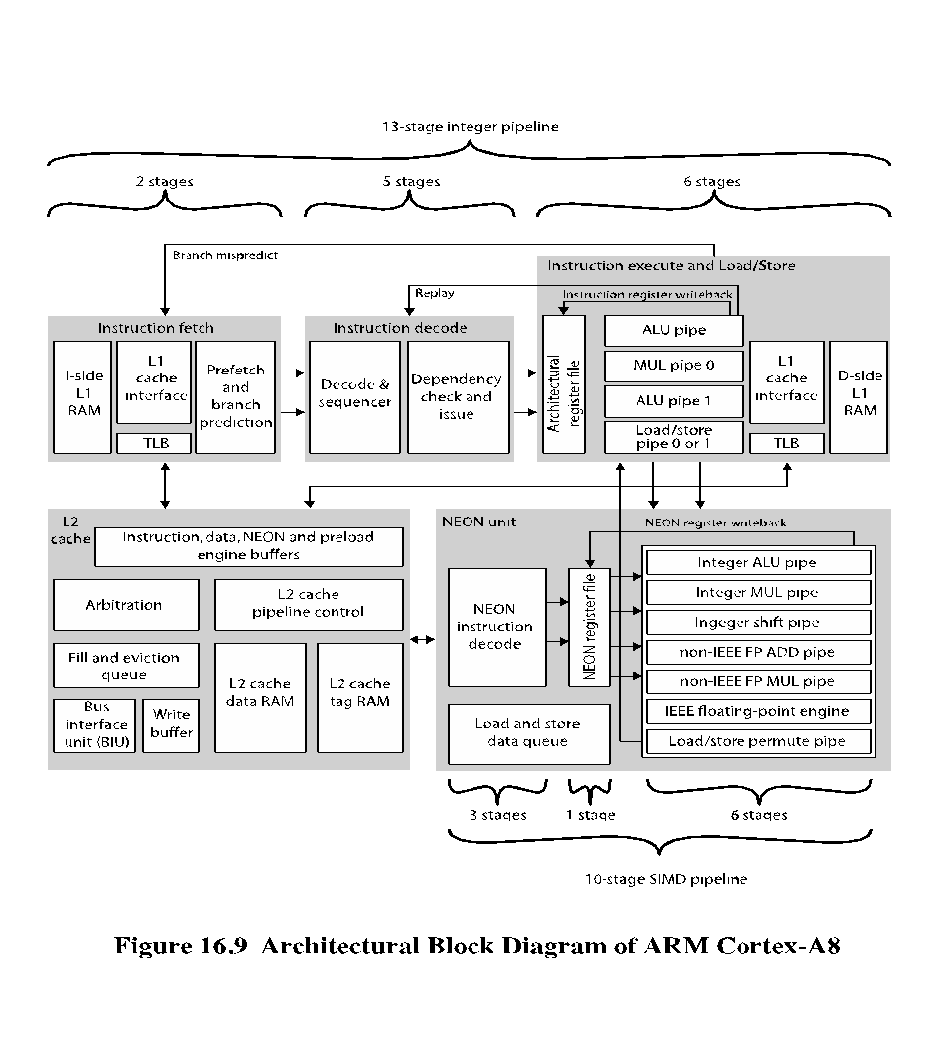
Notes:
Recent implementations of the ARM architecture have seen the introduction of
superscalar techniques in the instruction pipeline. In this section, we focus on the
ARM Cortex-A8, which provides a good example of a RISC-based superscalar
design.
The Cortex-A8 is in the ARM family of processors that ARM refers to as
application processors. An ARM application processor is an embedded processor
running complex operating systems for wireless, consumer and imaging applications.
The Cortex-A8 targets a wide variety of mobile and consumer applications
including mobile phones, set-top boxes, gaming consoles and automotive navigation/
entertainment systems.
Figure 16.9 shows a logical view of the Cortex-A8 architecture, emphasizing
the flow of instructions among functional units. The main instruction flow is
through three functional units that implement a dual, in-order-issue, 13-stage pipeline.
The Cortex designers decided to stay with in-order issue to keep additional
power required to a minimum. Out-of-order issue and retire can require extensive
amounts of logic consuming extra power.

Slide 28
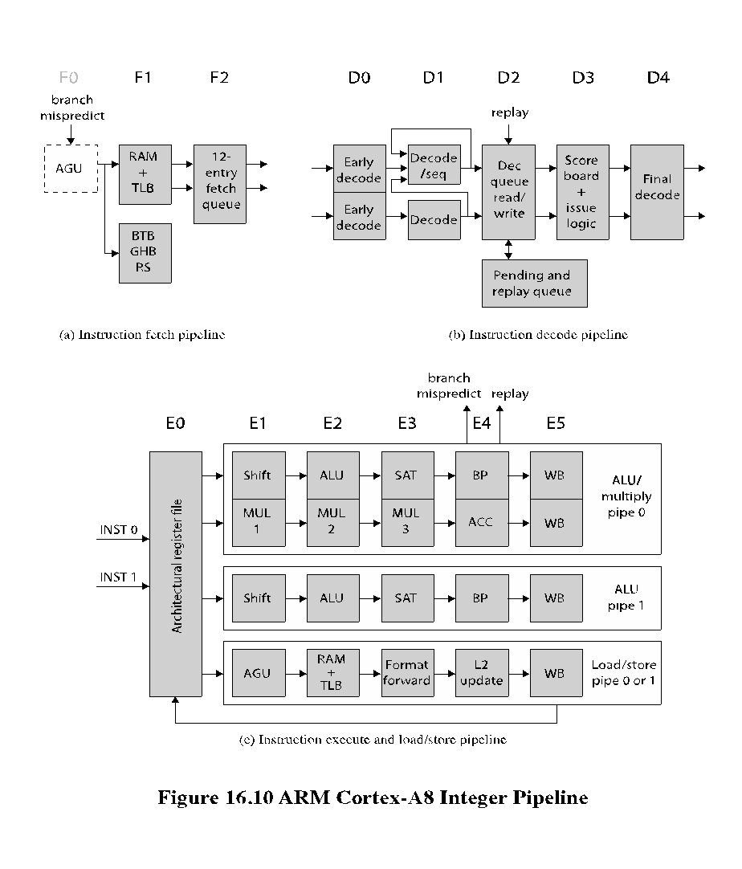
Notes:
Figure 16.10 shows the details of the main Cortex-A8 pipeline. There is a separate unit for SIMD (single-instruction-multiple-data) unit that implements a 10-stage pipeline.

Slide 29
Instruction Fetch Unit
F0
  Address generation unit (AGU) generates a new virtual address
  Not counted as part of the 13-stage pipeline
F1
  The calculated address is used to fetch instructions from the L1 instruction cache
  In parallel, the fetch address is used to access branch prediction arrays
F3
  Instruction data are placed in the instruction queue
  If an instruction results in branch prediction, new target address is sent to the address generation unit
Predicts instruction stream
Fetches instructions from the L1 instruction cache
Places the fetched instructions into a buffer for consumption by the decode pipeline
Also includes the L1 instruction cache
Speculative (there is no guarantee that they are executed)
Branch or exceptional instruction in the code stream can cause a pipeline flush
Can fetch up to four instructions per cycle
Notes:
The instruction fetch unit predicts the instruction stream, fetches instructions from the L1 instruction cache, and places the fetched instructions into a buffer for consumption by the decode pipeline. The instruction fetch unit also includes the L1 instruction cache. Because there can be several unresolved branches in the pipe- line, instruction fetches are speculative, meaning there is no guarantee that they are
executed. A branch or exceptional instruction in the code stream can cause a pipe- line flush, discarding the currently fetched instructions. The instruction fetch unit can fetch up to four instructions per cycle, and goes through the following stages:
F0 The address generation unit (AGU) generates a new virtual address. Normally, this address is the next address sequentially from the preceding fetch address. The address can also be a branch target address provided by a branch prediction for a previous instruction. F0 is not counted as part of the 13-stage pipeline, because ARM processors have traditionally defined instruction cache access as the first stage.
F1 The calculated address is used to fetch instructions from the L1 instruction cache. In parallel, the fetch address is used to access the branch prediction arrays to determine if the next fetch address should be based on a branch prediction.
F3 Instruction data are placed into the instruction queue. If an instruction results in branch prediction, the new target address is sent to the address generation unit.
To minimize the branch penalties typically associated with a deeper pipeline, the Cortex-A8 processor implements a two-level global history branch predictor, consisting of the branch target buffer (BTB) and the global history buffer (GHB). These data structures are accessed in parallel with instruction fetches. The BTB indicates whether or not the current fetch address will return a branch instruction and its branch target address. It contains 512 entries. On a hit in the BTB a branch is predicted and the GHB is accessed. The GHB consists of 4096 2-bit counters that encode the strength and direction information of branches. The GHB is indexed by 10-bit history of the direction of the last ten branches encountered and 4 bits of the PC. In addition to the dynamic branch predictor, a return stack is used to predict subroutine return addresses. The return stack has eight 32-bit entries that store the link register value in r14 and the ARM or Thumb state of the calling function. When a return-type instruction is predicted taken, the return stack provides the last pushed address and state.
The instruction fetch unit can fetch and queue up to 12 instructions. It issues instructions to the decode unit two at a time. The queue enables the instruction fetch unit to prefetch ahead of the rest of the integer pipeline and build up a backlog of instructions ready for decoding.

Slide 30
Instruction Decode Unit
Decodes and sequences all ARM and Thumb instructions
Dual pipeline structure, pipe0 and pipe1
  Two instructions can progress at a time
  Pipe0 contains the older instruction in program order
  If instruction in pipe0 cannot issue, instruction in pipe1 will not issue
All issued instructions progress in order
Results written back to register file at end of execution pipeline
  Prevents WAR hazards
  Keeps track of WAW hazards and recovery from flush conditions straightforward
  Main concern of decode pipeline is prevention of RAW hazards
Notes:
The instruction decode unit decodes and sequences all ARM and Thumb instructions. It has a dual pipeline structure, called pipe0 and pipe1, so that two instructions can progress through the unit at a time. When two instructions are issued from the instruction decode pipeline, pipe0 will always contain the older instruction in program order. This means that if the instruction in pipe0 cannot issue, then the instruction in pipe1 will not issue. All issued instructions progress in order down the execution pipeline with results written back into the register file at the end of the execution pipeline. This in-order instruction issue and retire prevents WAR hazards and keeps tracking of WAW hazards and recovery from flush conditions straightforward. Thus, the main concern of the instruction decode pipeline is the prevention of RAW hazards.

Slide 31
Instruction Processing Stages
D0
  Thumb instructions decompressed and preliminary decode is performed
D2
  Writes instructions into and read instructions from pending/replay queue
D4
  Final decode for control signals for integer execute load/store units
D1
  Instruction decode is completed
D3
  Contains the instruction scheduling logic
  Scoreboard predicts register availability using static scheduling
  Hazard checking is done
Notes:
Each instruction goes through five stages of processing.
D0 Thumb instructions are decompressed into 32-bit ARM instructions. A preliminary decode function is performed.
D1 The instruction decode function is completed.
D2 This stage writes instructions into and read instructions from the pending/ replay queue structure.
D3 This stage contains the instruction scheduling logic. A scoreboard predicts register availability using static scheduling techniques. Hazard checking is also done at this stage.
D4 Performs the final decode for all the control signals required by the integer execute and load/store units.
In the first two stages, the instruction type, the source and destination operands, and resource requirements for the instruction are determined. A few less commonly used instructions are referred to as multicycle instructions. The D1 stage breaks these instructions down into multiple instruction opcodes that are sequenced individually through the execution pipeline.
The pending queue serves two purposes. First, it prevents a stall signal from D3 from rippling any further up the pipeline. Second, by buffering instructions, there should always be two instructions available for the dual pipeline. In the case where only one instruction is issued, the pending queue enables two instructions to proceed down the pipeline together, even if they were originally sent from the fetch unit in different cycles.
The replay operation is designed to deal with the effects of the memory system on instruction timing. Instructions are statically scheduled in the D3 stage based on a prediction of when the source operand will be available. Any stall from the memory system can result in the minimum of an 8-cycle delay. This 8-cycle delay minimum is balanced with the minimum number of possible cycles to receive data from the L2 cache in the case of an L1 load miss.

Slide 32
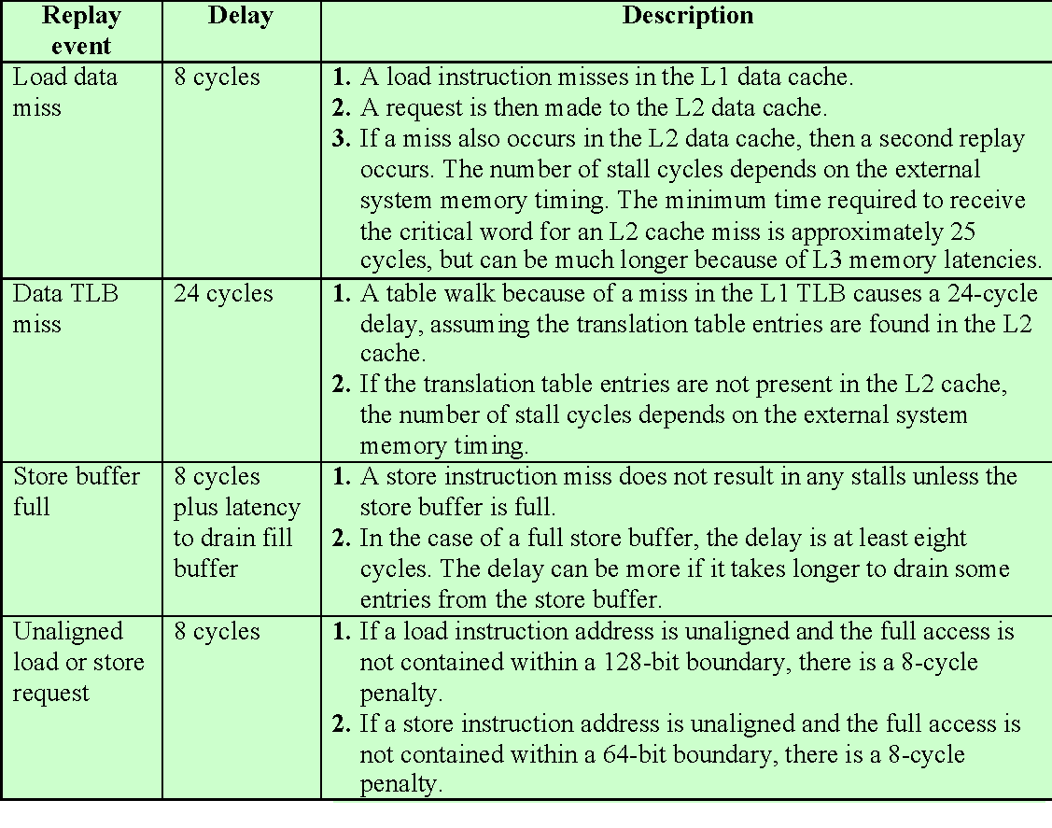
Table 16.3
Cortex-A8 Memory System Effects on Instruction Timings
(Table can be found on page 601 in the textbook.)
Notes:
Table 16.3 gives the most common cases
that can result in an instruction replay because of a memory system stall.
To deal with these stalls, a recovery mechanism is used to flush all subsequent instructions in the execution pipeline and reissue (replay) them. To support replay, instructions are copied into the replay queue before they are issued and removed as they write back their results and retire. If a replay signal is issued instructions are retrieved from the replay queue and reenter the pipeline.

Slide 33
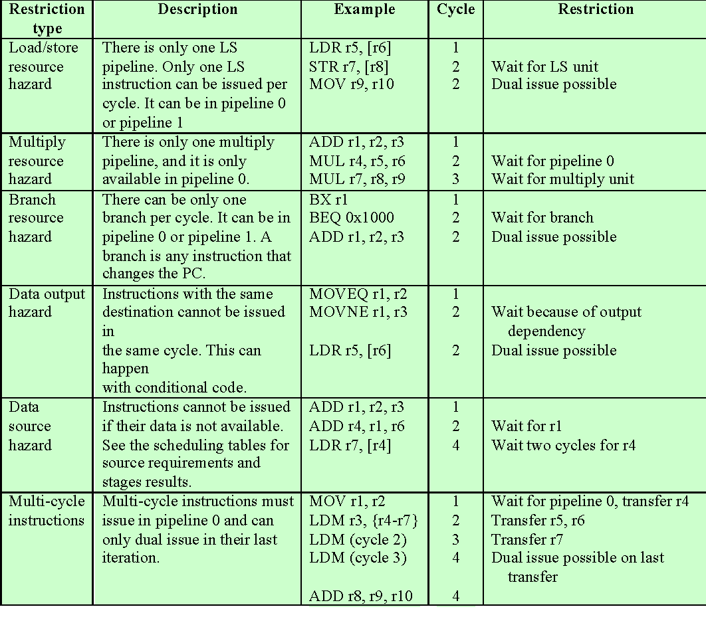
Table 16.4
Cortex-A8 Dual-Issue Restrictions
(Table can be found on page 602 in the textbook.)
Notes:
The decode unit issues two instructions in parallel to the execution unit, unless it
encounters an issue restriction. Table 16.4 shows the most common restriction cases.

Slide 34
Integer Execute Unit
Consists of:
  Two symmetric arithmetic logic unit (ALU) pipelines
  An address generator for load and store instructions
  The multiply pipeline
The instruction execute unit:
  Executes all integer ALU and multiply operations, including flag generation
  Generates the virtual addresses for loads and stores and the base write-back value, when required
  Supplies formatted data for stores and forwards data and flags
  Processes branches and other changes of instruction stream and evaluates instruction condition codes
For ALU instructions, either pipeline can be used, consisting of the following stages:
  E0
    Access register file
    Up to six registers for two instructions
  E1
    Barrel shifter if needed.
  E2
    ALU function
  E3
    If needed, completes saturation arithmetic
  E4
    Change in control flow prioritized and processed
  E5
    Results written back to register file
Notes:
The instruction execute unit consists of two symmetric arithmetic logic unit (ALU) pipelines, an address generator for load and store instructions, and the multiply pipeline. The execute pipelines also perform register write back. The instruction execute unit:
Executes all integer ALU and multiply operations, including flag generation
Generates the virtual addresses for loads and stores and the base write-back
value, when required
Supplies formatted data for stores and forwards data and flags
Processes branches and other changes of instruction stream and evaluates instruction condition codes
For ALU instructions, either pipeline can be used, consisting of the following stages:
E0 Access register file. Up to six registers can be read from the register file for two instructions.
E1 The barrel shifter (see Figure 14.25) performs its function, if needed. E2 The ALU unit (see Figure 14.25) performs its function.
E3 If needed, this stage completes saturation arithmetic used by some ARM data processing instructions.
E4 Any change in control flow, including branch misprediction, exceptions, and memory system replays are prioritized and processed.
E5 Results of ARM instructions are written back into the register file.
Instructions that invoke the multiply unit (see Figure 14.25) are routed to pipe0; the multiply operation is performed in stages E1 through E3, and the multi- ply accumulate operation in stage E4.

Slide 35

Load/Store Pipeline
Runs parallel to integer pipeline
E1
  Memory address generated from base and index register
E2
  Address applied to cache arrays
E3
  Load -- data are returned and formatted
  Store -- data are formatted and ready to be written to cache
E4
  Updates L2 cache, if required
E5
  Results are written back into the register file
Notes:
The load/store pipeline runs parallel to the integer pipeline. The stages are as follows:
E1 The memory address is generated from the base and index register.
E2 The address is applied to the cache arrays.
E3 In the case of a load, data are returned and formatted for forwarding to the ALU or MUL unit. In the case of a store, the data are formatted and ready to be written into the cache.
E4 Performs updates to the L2 cache, if required.
E5 Results of ARM instructions are written back into the register file.

Slide 36
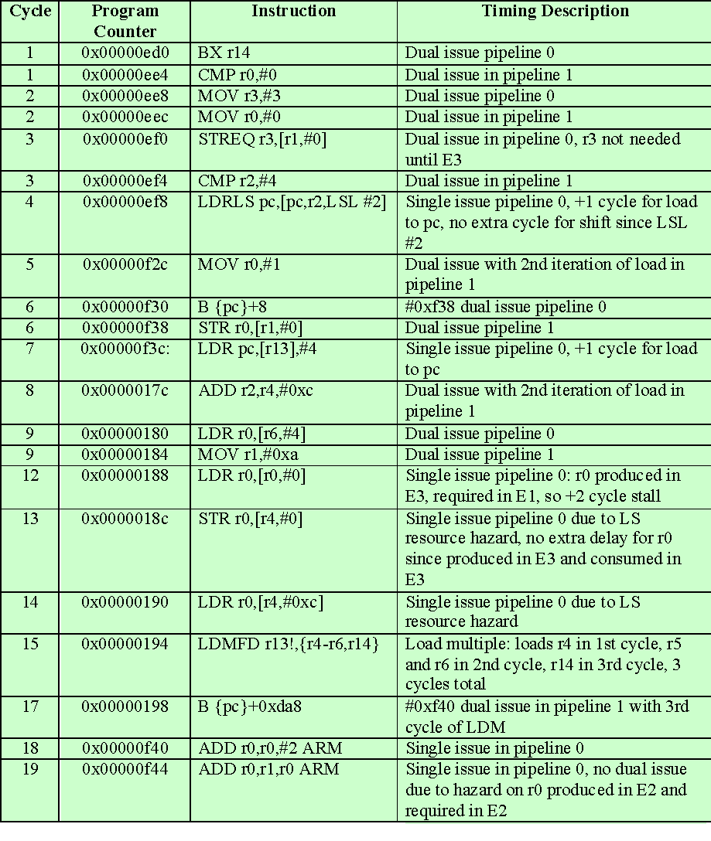
Table 16.5
Cortex-A8
Example
Dual Issue
Instruction Sequence for
Integer Pipeline
(Table can be found on page 603 in the textbook.)
Notes:
Table 16.5 shows a sample code segment and indicates how the processor might schedule it.

Slide 37
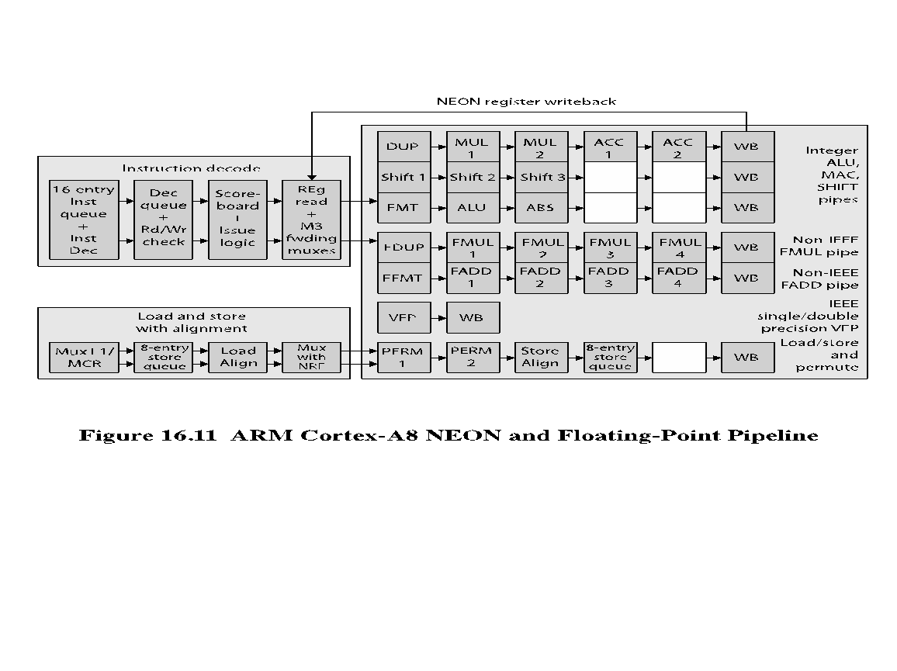
Notes:
All SIMD and floating-point instructions pass through the integer pipeline and are processed in a separate 10-stage pipeline (Figure 16.11). This unit, referred to as the NEON unit, handles packed SIMD instructions, and provides two types of floating- point support. If implemented, a vector floating-point (VFP) coprocessor performs floating-point operations in compliance with IEEE 754. If the coprocessor is not present, then separate multiply and add pipelines implement the floating-point operations.

Slide 38
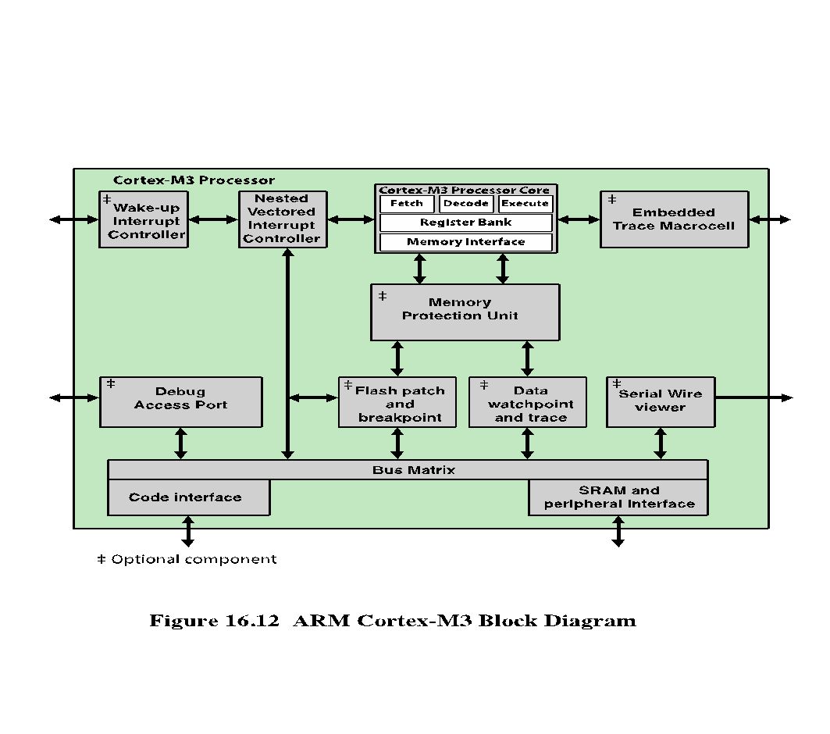
Notes:
The preceding section looked at the rather complex pipeline organization of the
Cortex-A8, an application processor. As a useful contrast, this section examines the
considerably simpler pipeline organization of the Cortex-M3. The Cortex-M series is
designed for the microcontroller domain. As such, the Cortex-M processors need to
be as simple and efficient as possible.
Figure 16.12 provides a block diagram overview of the Cortex-M3 processor.
This figure provides more detail than that shown in Figure 1.16. Key elements include:
■ Processor core: Includes a three-stage pipeline, a register bank, and a memory
interface.
■ Memory protection unit: Protects critical data used by the operating system
from user applications, separating processing tasks by disallowing access
to each other’s data, disabling access to memory regions, allowing memory
regions to be defined as read-only, and detecting unexpected memory accesses
that could potentially break the system.
■ Nested vectored interrupt controller (NVIC): Provides configurable interrupt
handling abilities to the processor. It facilitates low-latency exception and
interrupt handling, and controls power management.
■ Wake-up interrupt controller (NVIC): Provides configurable interrupt handling
abilities to the processor. It facilitates low-latency exception and interrupt
handling, and controls power management.
■ Flash patch and breakpoint unit: Implements breakpoints and code patches.
■ Data watchpoint and trace (DWT): Implements watchpoints, data tracing,
and system profiling.
■ Serial wire viewer: Can export a stream of software-generated messages, data
trace, and profiling information through a single pin.
■ Debug access port: Provides an interface for external debug access to the
processor.
■ Embedded trace macrocell: Is an application-driven trace source that supports
printf() style debugging to trace operating system and application events, and
generates diagnostic system information.
■ Bus matrix: Connects the core and debug interfaces to external buses on the
microcontroller.

Slide 39
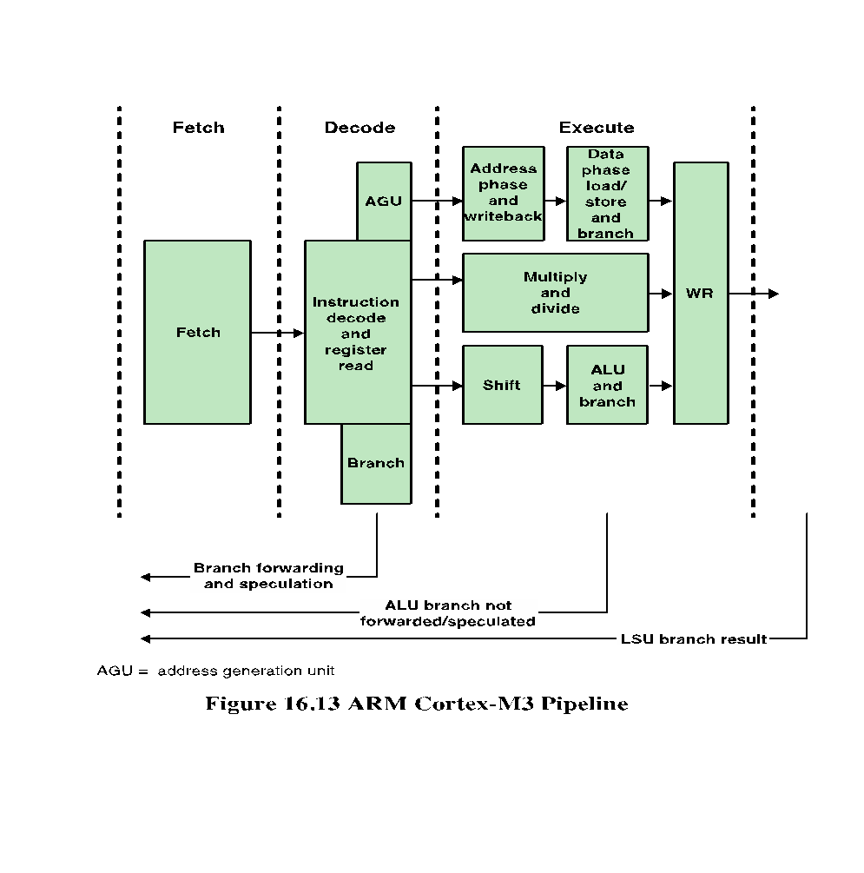
Notes:
To keep the processor as simple as possible, the Cortex-M3 processor does not use
branch prediction, but instead use the simple techniques of branch forwarding and
branch speculation, defined as follows:
■ Branch forwarding: The term forwarding refers to presenting an instruction
address to be fetched from memory. The processor forwards certain branch
types, by which the memory transaction of the branch is presented at least
one cycle earlier than when the opcode reaches execute. Branch forwarding
increases the performance of the core, because branches are a significant part
of embedded controller applications. Branches affected are PC relative with
immediate offset, or use link register (LR) as the target register.
■ Branch speculation: For conditional branches, the instruction address is presented
speculatively, so that the instruction is fetched from memory before it
is known if the instruction will be executed.
The Cortex-M3 processor prefetches instruction ahead of execution using
the fetch buffer. It also speculatively prefetches from branch target addresses. Specifically,
when a conditional branch instruction is encountered, the decode stage
also includes a speculative instruction fetch that could lead to faster execution.
The processor fetches the branch destination instruction during the decode stage
itself. Later, during the execute stage, the branch is resolved and it is known which
instruction is to be executed next.
If the branch is not to be taken, the next sequential instruction is already available.
If the branch is to be taken, the branch instruction is made available at the
same time as the decision is made, restricting idle time to just one cycle.
Figure 16.13 clarifies the manner in which branches are handled, which can be
described as follows:
1. The decode stage forwards addresses from unconditional branches and speculatively
forwards addresses from conditional branches when it is possible to
calculate the address.
2. If the ALU determines that a branch is not taken, this information is fed back
to empty the instruction cache.
3. A load instruction to the program counter results in a branch address to be
forwarded for fetching.
As can be seen, the manner in which branches are handled is considerably
simpler for the Cortex-M than the Cortex-A, requiring less processor logic and
processing.

Slide 40
Summary
Instruction-Level Parallelism and Superscalar Processors
Chapter 16
Intel core microarchitecture
  Front end
  Out-of-order execution logic
  Integer and floating-point execution units
ARM Cortex-A8
  Instruction fetch unit
  Instruction decode unit
  Integer execute unit
  SIMD and floating-point pipeline
  ARM Cortex-M3
  Pipeline structure
  Dealing with branches
Superscalar versus Superpipelined
  Constraints
Design issues
  Instruction-level parallelism
  Machine parallelism
  Instruction issue policy
  Register renaming
  Branch prediction
  Superscalar execution
  Superscalar implementation
Notes:
Chapter 16 summary.

